Slide 1
SMARTPLANT 3D GRIDS TASK
SP3D Version 2011 SP1

Slide 2

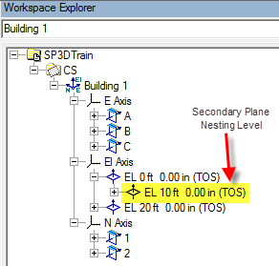
Coordinate Systems
One global coordinate system per model database
One or more Design coordinate systems
Design coordinate system is a persisted object
Graphically indicated by a view zoom independent triad
Appears in the Workspace Explorer
CS Name can be user defined
Creation of a Design coordinate system can be done using the Place Coordinate System command or the Grid Wizard command
Plane nesting level can be seen in the Workspace Explorer
© 2005. Intergraph Corporation. All Rights Reserved.

Slide 3
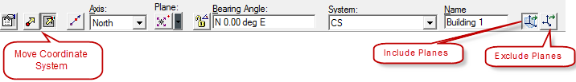
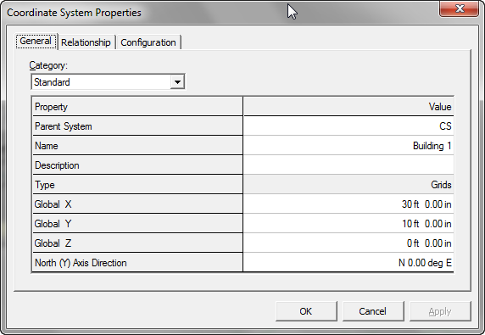
Coordinate Systems
Coordinate System Ribbon Bar and Properties Page
  Setting
  Origin step
  Axis Direction step
  Reference Axis
  Bearing angle ( From Dir xx deg To Dir)
  System
  Name
  Move Coordinate System (Include Planes/Exclude Planes)
© 2005. Intergraph Corporation. All Rights Reserved.

Slide 4
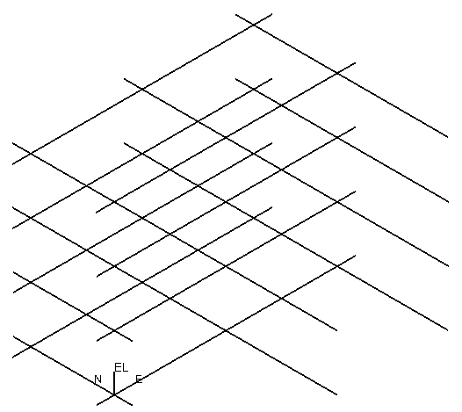
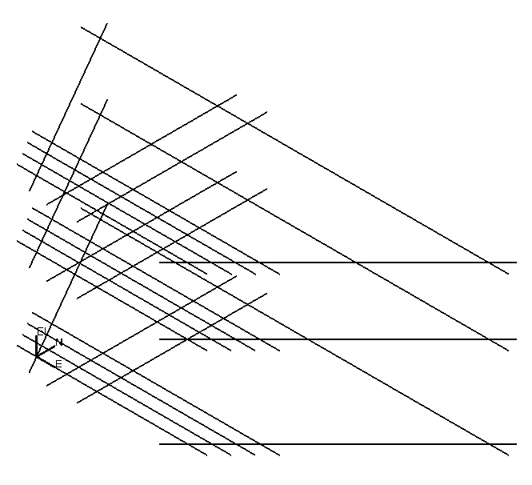
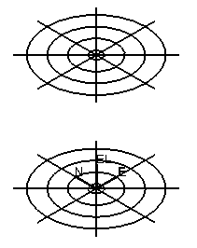
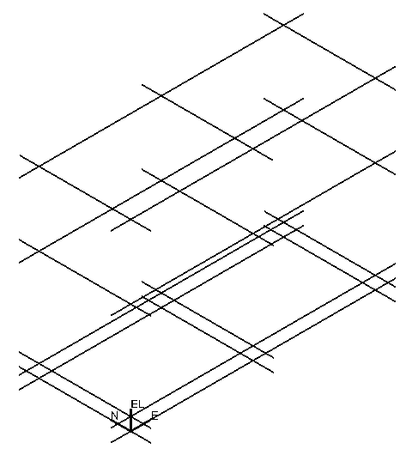
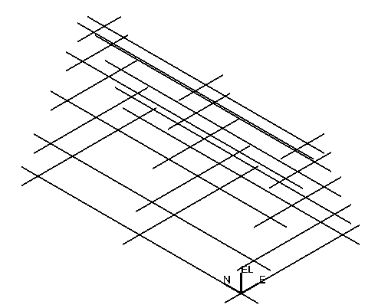
Grid Systems
Most Grid Systems are defined early in the design activity to establish the primary positional references (layout) for the design
Sets of gridlines defined by reference planes
Imposes rectangular/skewed/radial frame
Associative behavior
Rule based Naming Rule
© 2005. Intergraph Corporation. All Rights Reserved.

Slide 5
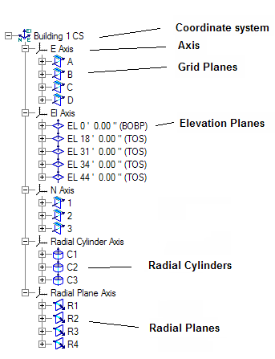
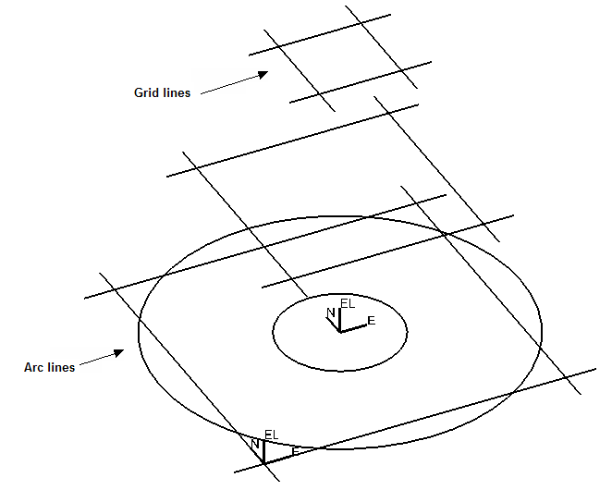
Grid Entities
Coordinate system
Axis
Elevation Planes
Grid Planes
Radial Planes
Radial Cylinders
Gridlines
Grid Arcs
© 2005. Intergraph Corporation. All Rights Reserved.

Slide 6
Grid Wizard Command
The intend of this command is to help users in the creation of elevation and reference planes.
Step 1 – Establish a Design coordinate system. Select Grid Type (Rectangular/Cylindrical/Both)
Given below are the steps for creating Rectangular Grids
Step 2 – Create the Elevation planes
Step 3 – Create the Easting planes
Step 4 – Create the Northing planes
Step 5 – Select arbitrary elevation planes from each
reference plane to produce gridlines for the grid system
Grid wizard command can also be used to edit grid planes.
© 2005. Intergraph Corporation. All Rights Reserved.

Slide 7
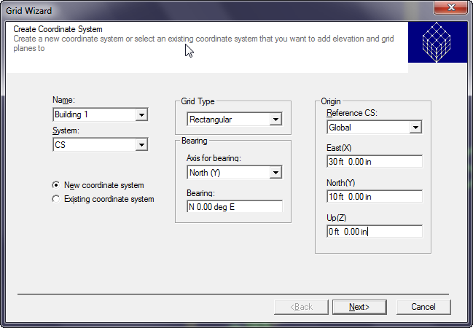
Grid Wizard Command
Grid Wizard Step 1 command
The grid wizard command uses the last inputs.
© 2005. Intergraph Corporation. All Rights Reserved.

Slide 8
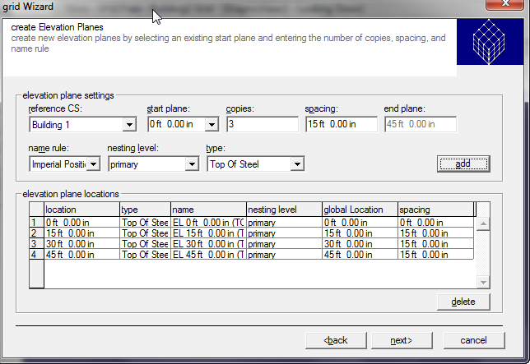
Grid Wizard Command
Grid Wizard Step 2 command
Start plane: Defines starting location of the first plane
Copies: Number of copies of El. planes to be created
Spacing: Defines the spacing to be used between El. planes.
End Plane: Shows the location of the last plane
Name Rule: Rule to label the El. planes.
Type: Elevation type
Add: Adds multiple EL. Plane to the table based on the settings.
Example of Naming Rule
By Index ElevPlane1, ElevPlane2
    By Position El 10m, El 20m
© 2005. Intergraph Corporation. All Rights Reserved.

Slide 9
Grid Reference Plane Types
Grid Wizard Command
User-definable code-list values
Useful for filters, name rules, connection rules
Elevation Plane Types
  Undefined
  Top Of Steel
  Top Of Concrete
  Bottom Of Base plate
  Bottom Of Concrete
  Column Splice Elevation
  Grade Elevation
  Reference Plane Types
    Undefined
    N-S Grid Plane
    E-W Grid Plane
    Expansion Join Plane
© 2005. Intergraph Corporation. All Rights Reserved.

Slide 10
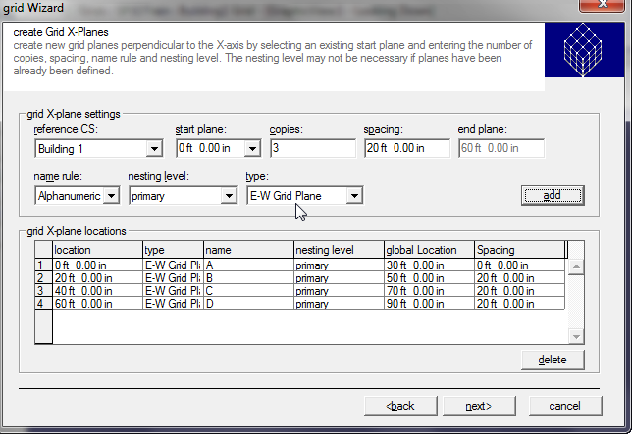
Grid Wizard Command
Grid Wizard Step 3 command
Start plane: Defines starting location of the first plane.
Copies: Number of copies of X-Planes to be created.
Spacing: Defines the spacing to be used between X-Planes.
End Plane: Shows the location of the last plane.
Name Rule: Rule to label the X-Planes.
Nesting Level: primary, secondary, tertiary.
Type: Grid type
Add: Adds multiple X-plane to the table based on the settings.
© 2005. Intergraph Corporation. All Rights Reserved.

Slide 11

Grid Wizard Command
Grid Wizard Step 4 command
Start plane: Defines starting location of the first plane.
Copies: Number of copies of Y-Planes to be created.
Spacing: Defines the spacing to be used between Y-Planes.
End Plane: Shows the location of the last plane.
Name Rule: Rule to label the Y-Planes.
Nesting Level: primary, secondary, tertiary.
Type: Grid type
Add: Adds multiple Y-Plane to the table based on the settings.
© 2005. Intergraph Corporation. All Rights Reserved.

Slide 12
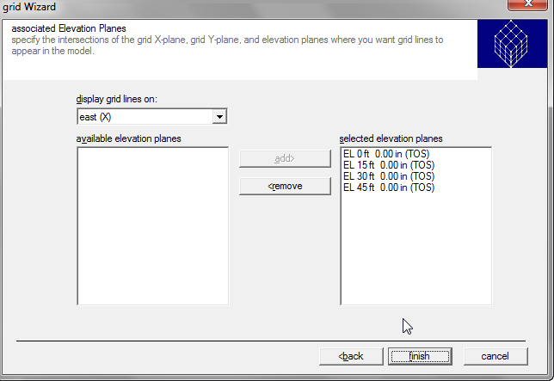
Grid Wizard Command
Grid Wizard Step 5 command
Select arbitrary elevation planes from each grid plane to produce grid lines/arcs for the grid system.
All grid lines/arcs are displayed for each X and Y planes by default.
© 2005. Intergraph Corporation. All Rights Reserved.

Slide 13
SP3D GRIDS TASK LAB
Labs 1A – 1C
© 2005. Intergraph Corporation. All Rights Reserved.

Slide 14
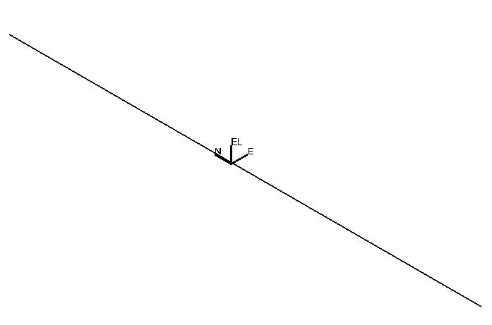
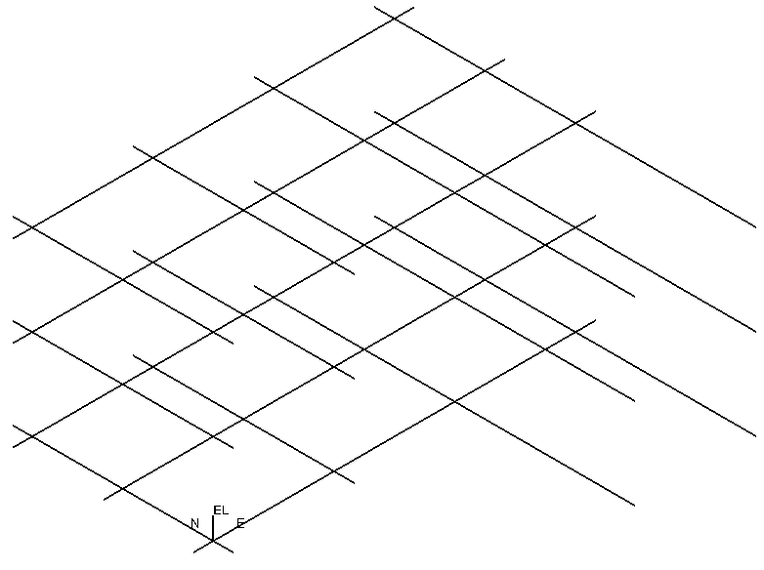
Grid Systems
The default of an unbounded grid line is 100 meters
By default, grid line extends by 1 meter distance past last bounding grid planes. Grid planes can be extended if required.
100 meter
1meter
Grid Extension
© 2005. Intergraph Corporation. All Rights Reserved.

Slide 15
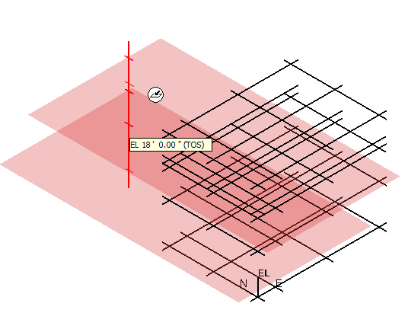
Grid Entities Manipulation
Place/Edit Elevation Plane Command
Control-Shift select Elevation Planes from Rulers (like WSE)
Dynamic display of new Elevation Plane location on ruler
Multi-Select El Planes
Dynamic
Display
© 2005. Intergraph Corporation. All Rights Reserved.

Slide 16
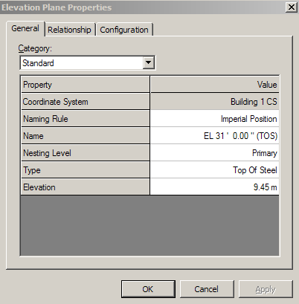
Grid Entities Manipulation
Place/Edit Elevation Plane ribbon bar
and Properties Page
Position step
CS
Type
Reference
Offset
Copies
Nesting level
© 2005. Intergraph Corporation. All Rights Reserved.

Slide 17
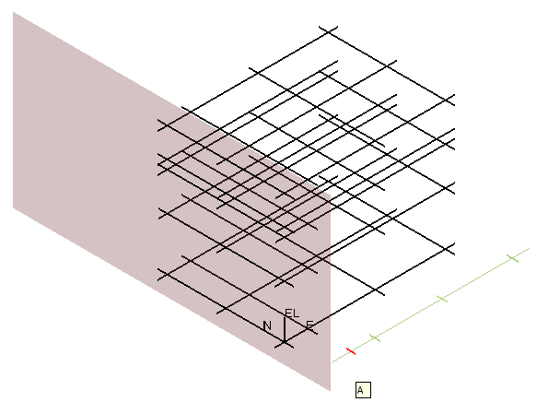
Grid Entities Manipulation
Place/Edit Grid Plane Command
Control-Shift select Grids Planes
from Rulers (like WSE)
Dynamic display of new Grid
Plane location on ruler
Dynamic
Display
Multi-Select Grid Planes
© 2005. Intergraph Corporation. All Rights Reserved.

Slide 18
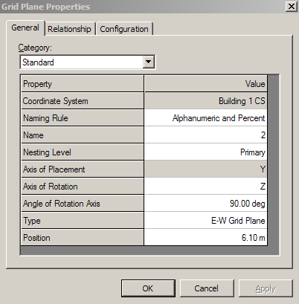
Grid Entities Manipulation
Place/Edit Grid Plane ribbon bar
and Properties Page
Position step
CS
Axis
Type
Reference
Offset
Copies
Nesting level
© 2005. Intergraph Corporation. All Rights Reserved.

Slide 19
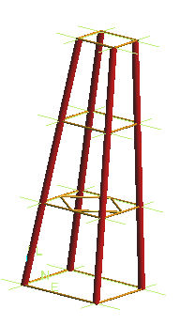
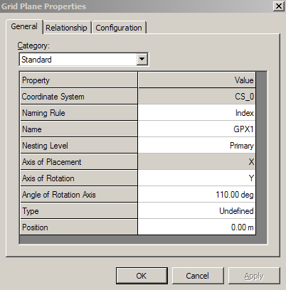
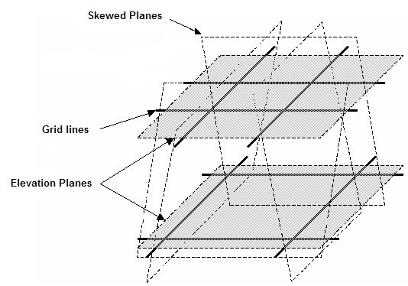
Grid Entities Manipulation
Skewed Grid Plane
Towers
Offshore Jackets
© 2005. Intergraph Corporation. All Rights Reserved.

Slide 20
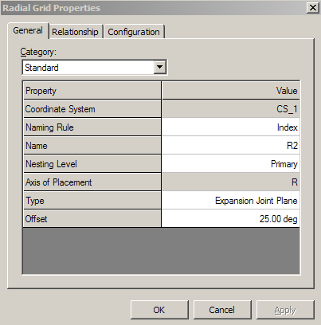
Grid Entities Manipulation
Place/Edit Radial Plane ribbon bar
and Properties Page
Position step
CS
Axis
Type
Reference
Offset
Copies
Nesting level
© 2005. Intergraph Corporation. All Rights Reserved.

Slide 21
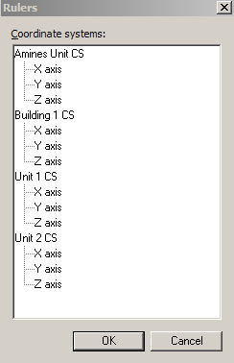
Rulers
Rulers control the display of reference planes loaded in a workspace. When you place objects in the model, you can use rulers to help you locate the exact point along a plane
Displays all the coordinate systems defined for the model
Use the Ctrl key and select coordinate system node will automatically selects all axis to turn on/off the rulers
© 2005. Intergraph Corporation. All Rights Reserved.

Slide 22
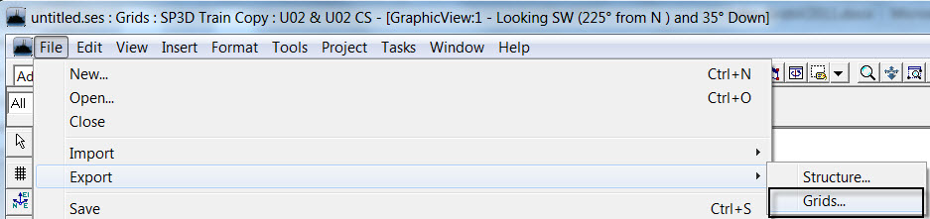
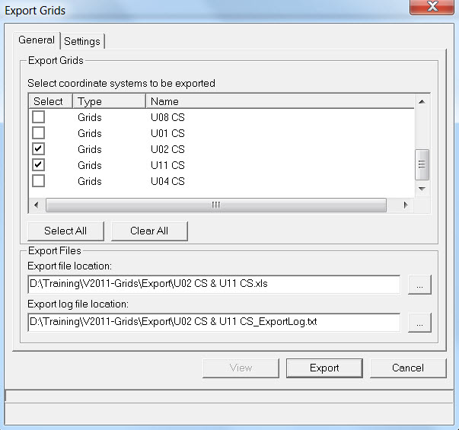
Grids Export - Import
The File > Export > Grids command exports the coordinate system to a XLS or XML file.
The exported file contains all needed information to import the coordinate system into a different model.
© 2005. Intergraph Corporation. All Rights Reserved.

Slide 23
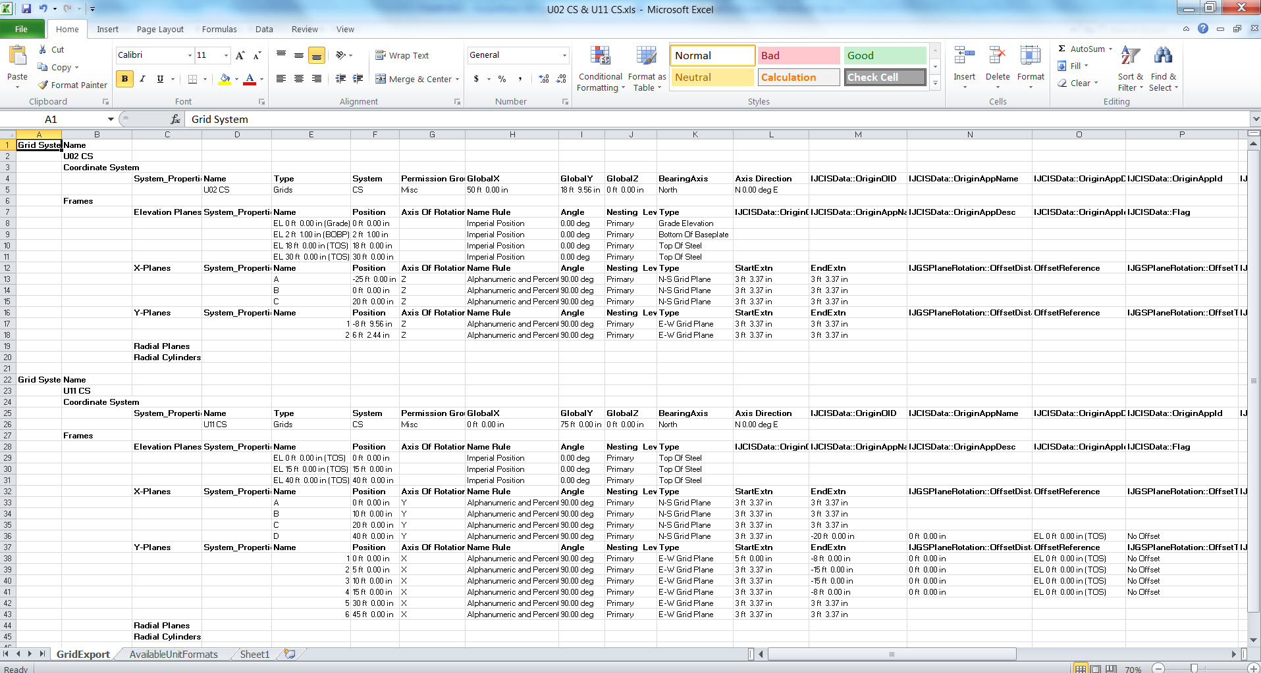
Grids Export - Import
Exported grids saved to XLS file.
© 2005. Intergraph Corporation. All Rights Reserved.

Slide 24
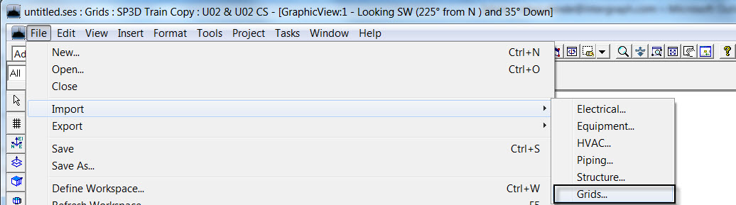
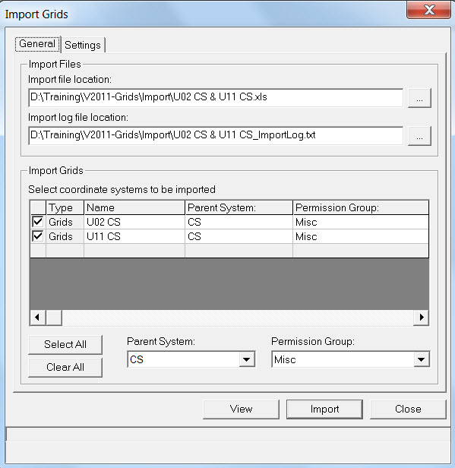
Grids Export - Import
The File → Import → Grids command imports a coordinate system into the model.
This command recognizes XML and XLS files that have been exported from a different model.
User can modify the distance and angles in the exported XML or XLS in any accepted Units of Measure formats, and then import.
© 2005. Intergraph Corporation. All Rights Reserved.

Slide 25
SP3D GRIDS TASK LAB
Labs 2 – 8
© 2005. Intergraph Corporation. All Rights Reserved.

